Slide 1


Hope to Skills
Lecture# 19
Irfan Malik, Dr. Sheraz Naseer

Slide 2
Agenda
Regression Models
Linear Regression
Decision Tree Regressor
Random Forest Regressor
Gradient Boosting Regressor
Hands-on Using Scikit Learn

Slide 3
Previous lecture:
Lecture 18 - Classification
Click Here

Slide 4
Different Regression Techniques

Slide 5
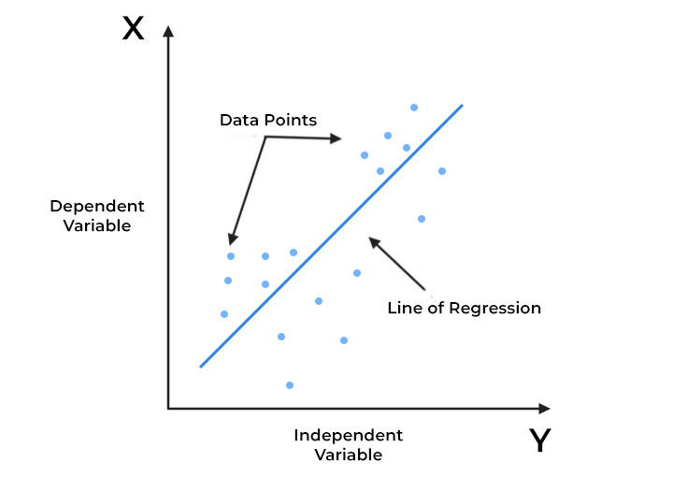
Linear Regression
Linear regression is a supervised machine learning algorithm used for predicting a continuous output (dependent variable) based on one or more input features (independent variables).

Slide 6
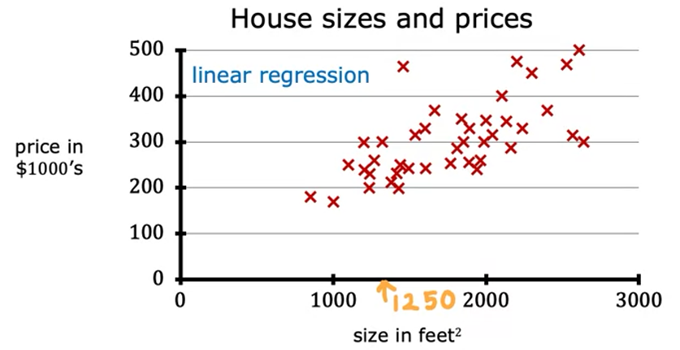
Linear Regression

Slide 7
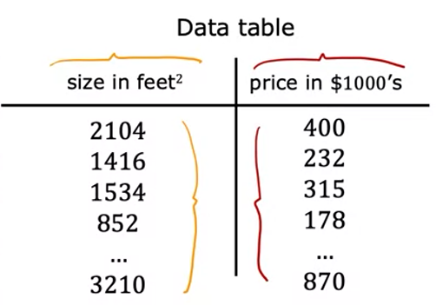
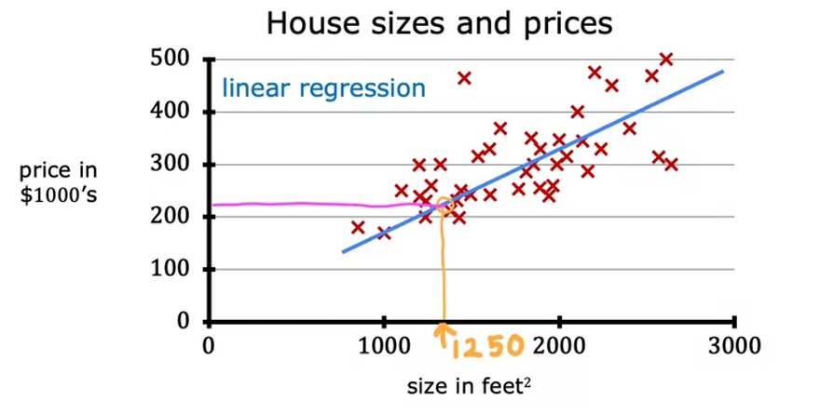
Linear Regression

Slide 8
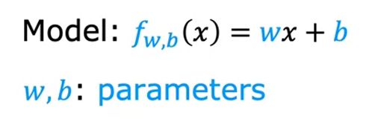
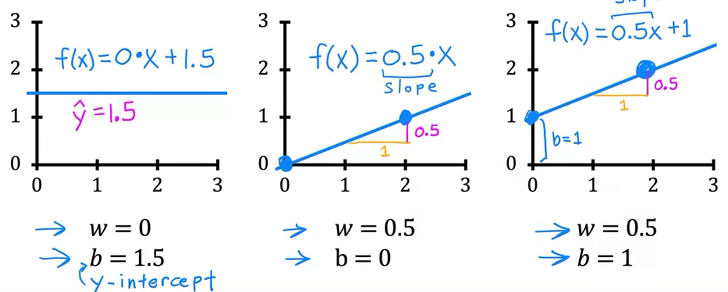
Linear Regression

Slide 9
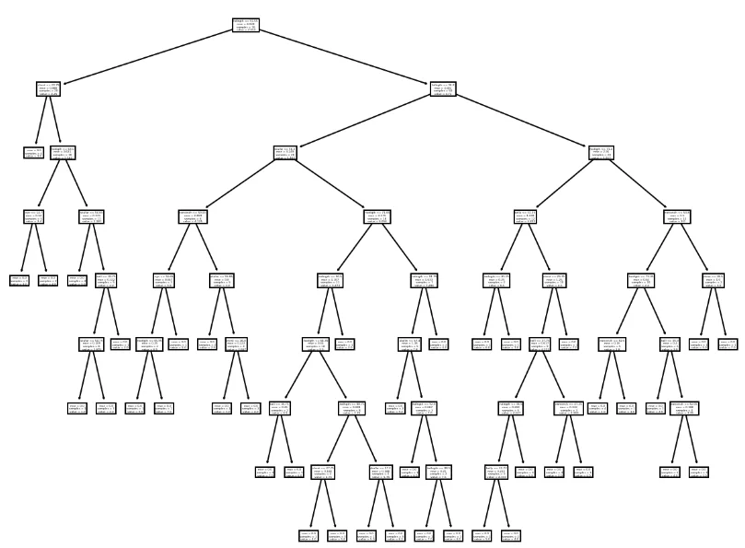
Decision Tree Regressor
Decision tree regression involves partitioning the data into subsets based on the values of independent variables and predicting the average of the target variable for each subset.

Slide 10
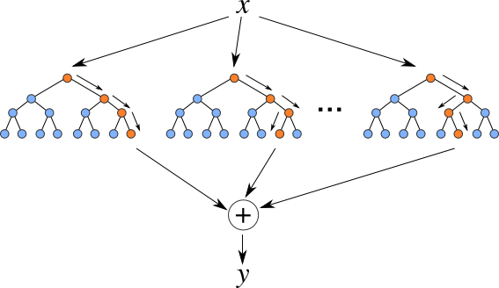
Random Forest Regressor:
Random Forest is learning method that creates multiple decision trees during training and outputs the average prediction (for regression) from all individual trees.

Slide 11
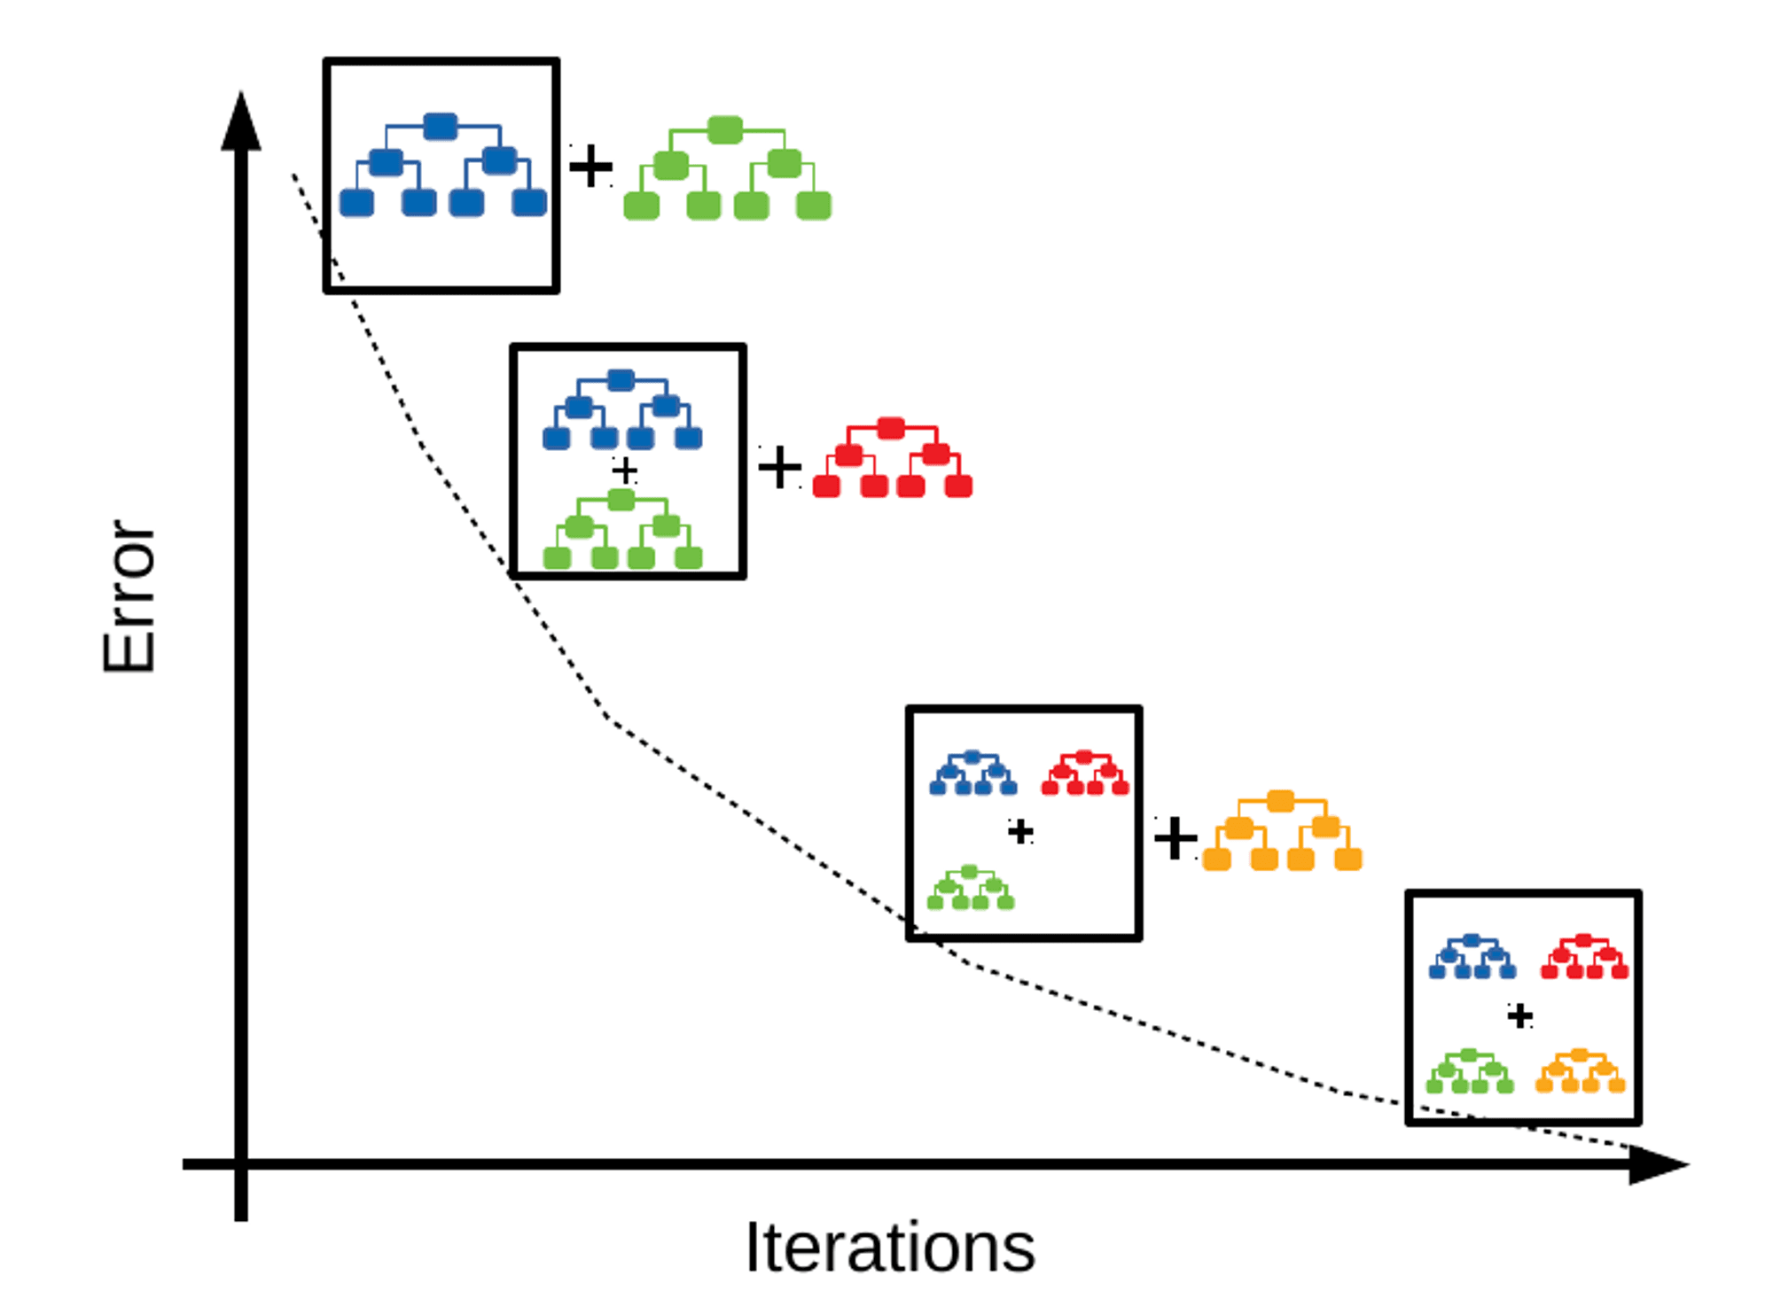
Gradient Boosting Regressor
Gradient Boosting is learning technique that builds multiple decision trees sequentially, each one correcting the errors of its predecessor.

Slide 12
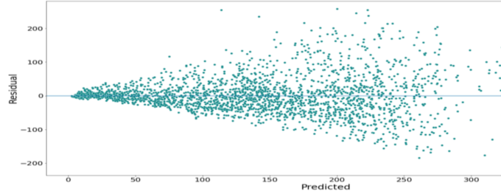
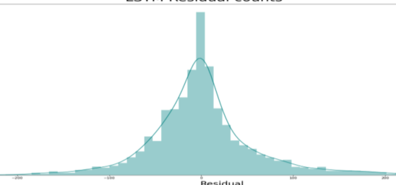
Residual Analysis:
Residual analysis is a technique for evaluating the validity of a linear regression model by examining the patterns of residuals.
A residual is the difference between the observed value and the predicted value of a quantity of interest.

Slide 13
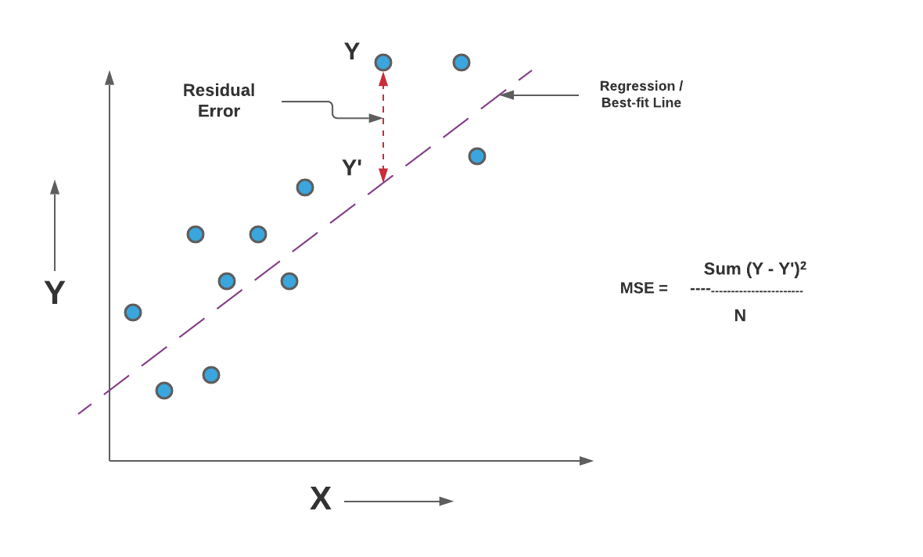
Mean Squared Error (MSE)
The Mean Squared Error (MSE) is a common evaluation metric used in regression tasks.
It measures the average squared difference between the actual and predicted values.

Slide 14
Next Lecture:
Lecture 20 - Evaluation Metrics I
Click Here

